Slide 1
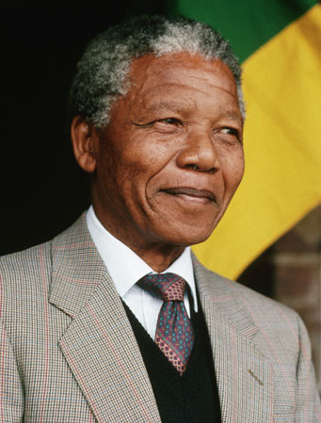
Nelson mandela
By Student A

Slide 2
WHO IS NELSON MANDELA?
Nelson Mandela was born in july 18 1918 and died in december 5th 2013
He was the first black president of south Africa
One of the first people to stop racism in the world
Was sent to jail for 27 years at Robben island for being one of the presidents of the African national congress and not listening to the rules of the white he was only allowed one visitor once a year for 30 minutes

Slide 3
nelson mandela’s childhood
Was originally born as Rolihlahla Mandela
his father was the chief off the village he was born in
He grew up in a village called Qunu
He spent most of his early years playing with boys and working cattle
His parents realized the importance of education so they sent him to a Methodist school when he was 7
2 years later his teacher gave him his first name as Nelson
He then went to the university of fort but was told to leave for breaking to many policies
When he came back to his village he realized he had an arranged marriage so he run away from his village
He moved to Johannesburg in 1941 and joined the African national congress activist (ANC)

Slide 4
Work of the past and present
He started his work with the AFC for the youths
He’s night job was a security officer for mines
He then became the president of the AFC
Hes main job was to stop racism
Got sent to jail for Standing up against a government that was committing egregious human rights abuses against black South Africans. He was released from prison in 1990 and went on to lead the way for the abolition of apartheid in 1994.
Lots of people wanted him to go free so he was sent free in 1990
Became the first black president of south Africa in 1994 but decided to stop being president in 1999
Won the noble prize in 1993 for peace

Slide 5
His awards
1980 - Jawaharlal Nehru Award 1993 - Noble Prize 1990 - Bharat Ratna Award
1990 - Lenin Peace Prize 1991 - Carter-Menil Human Rights Prize 1992 - Nishan-e-Pakistan Award 1999 - Atatürk Peace Award 2001 - International Gandhi Peace Prize

Slide 6
work as humanitarians and his effects on today’s world
Mandelas work as a humanitarian was by stopping the over population of white people in south Africa
He was sent to life prison but was then sent out after 27 years
“The time for the healing of the wounds has come. The moment to bridge the chasms that divide us has come” he said when he was accept as president
He has also changed how the world is now and without him racism might of still be a thing In the world and not be the way it is today

Slide 7
Thank you for listening

